Slide 1
NGIT Target State Architecture Views
October 2017

Slide 2
NGIT Architecture Views
Enterprise Architecture Team – Overview
Go-Forward Business Value Chain
Program Value Chain and Integration
Target State Architecture Views by Solution Area
eCommerce & CPQ
Order Management and Services
Supply Chain
Finance
Enterprise Analytics

Slide 3

Enterprise Architecture Team – Overview
 | Deliver Architecture POV, Transient Architecture and Impact Assessments Support larger workstreams (SERP, EA,IF etc.) and drive architecture program goals Serve as advisory role to the workstreams, DXC and the business
Objective
Strategy
Enterprise Architecture
Execution
Strategy and Planning Deliverables
Target State Architecture View – End state architecture view that show the target state for all solution areas
Transient Architecture View – Architecture view by release identifying integration and application changes
CRP Architecture View – Context setting high-level architecture view by solution area (includes new and legacy apps)

Slide 4
Go-Forward Business Value Chain
Process Area
R&D and Design
Go-to-Market
Operations
(Sales Operations, Supply Chain, and Order Management)
Global Functions
Process Group
Concept to Production
Plan to Market
Quote to Cash
Make/Engineer to Order
Procure to Pay
Request to Service
Record to Report
Hire to Retire
Common Core
Product & Services Lifecycle Management
Perform Go-to-Market Strategy
Configure, Price and Quote
Manufacture Products
Procure Materials and Services
Manage Spare Parts
Manage Accounting and Control Data
Manage Human Resources
Manage Information Technology
Conduct R&D Activities
Market Products and Services
Sales Compensation Administration
Manage Plant & Equipment
Conduct Warehousing & Logistics
Manage Warranty, Repair & Returns
Manage Capital and Risk
Business & Corporate Strategy
Processes
Perform Order Management
Conduct Supply & Demand Planning
Perform Supplier Management
Perform Consulting Services
Perform Statutory Legal & Compliance Reporting
Manage Programs
Manage Billing and Collections
Conduct Sales Planning
Manage Flexible Consumption
Plan & Manage Business
Provide Decision Support

Slide 5













Core platforms
Delivering foundational capabilities necessary for IT-enabled business transformation
Engineering & Product Design
Marketing
Sales Automation & CRM
Sales & Partner Compensation
Configure Price Quote eCommerce Engine
Order Mgmt., Supply Chain & Finance
MDM Product, Customer & Finance
Human Resources & Payroll
Digital Experience
Next-gen Analytics
Integration Fabric
IT4IT
Security
Framework

Slide 6
Per Core Platform
Architecture Views
Transient View – 1.x to 2.x
NGIT Target State – post 2.4 (funded)
True Target State (additional Opportunity)
Layers:
Business Process View – Business Leads – Mike Herbert
Data Flow, and Standard exposed API’s/services – EA
Platform (includes software, servers, Authentication Management, etc) – EA/Infrastructure (PointNext, Deloitte)
Operationalization

Slide 7
Program Value Chain and Integration
Primary Focus of NGIT Program
Minimal Investment
Service
Delivery &
Financial Services
Opportunity
CPQ
Service Request RFQ
SERP
Service Request Quote details
Plan to Market
Quote to Cash
Installed Base
Product Availability
Renewal Opty & Quote
Concept to Production
Quote to Cash
Make/Engineer to Order
Procure to Pay
Request to Service
Record to Report
Order
Manage Warranty, Repair & Returns
Perform Go-to-Market Strategy
Configure, Price and Quote
Entitlement
Oppty
Product & Service Lifecycle Management
Configure, Price and Quote
Manufacture Products
Procure Materials and Services
Manage Spare Parts
Manage Accounting and Control Data
Perform Consulting Services
Market Products and Services
Sales Compensation Administration
Quote
sync
Conduct R&D Activities
Sales Compensation Administration
Manage Plant & Equipment
Conduct Warehousing & Logistics
Manage Warranty, Repair & Returns
Manage Capital and Risk
Resources Assigned
Manage Human Resources
Provide Decision Support
Volumetric
Data
Product
Demand
Signal
Perform Order Management
Conduct Supply & Demand Planning
Perform Supplier Management
Perform Consulting Services
Perform Statutory Legal & Compliance Reporting
Financial Services (Separate ERP, EA, and CPQ)
Convert to Order
Manage Billing and Collections
Conduct Sales Planning
Manage Flexible Consumption
Plan & Manage Business
R&D & Design & Marketing
Customer List Prices
Product Master Service Master Employee / Skills / Labor rates
Concept to Production
Plan to Market
Provide Decision Support
Real-time - All Transactions
Product & Services Lifecycle Management
Perform Go-to-Market Strategy
General Ledger
Cost Centers
Profit Centers
MRU
Person
Employee
Job Code
Skill Codes
Conduct R&D Activities
Market Products & Services
NPI,
Contra
Product & Services Info
Customer
Vendor
Prices
Costs
Products
Services
Parts
Bundles
Finance elements
Enterprise Structure
Real-time - All Transactions
Other Party
Customer
Vendor
Partner
Product
Offerings
Packages
Materials
Hierarchies
Pricing
Catalogs
Product IDs
BOM/BOL/BOS
Finance
GL
Cost Objects
WBS
Profit Center
Business Area
Company Codes
Tax Hierarchy
Reference
Geography
Currency
Country Codes
Tax Codes
Time Dimensions
Alt. Hierarchies
Perform Go-to-Market Strategy
Provide Decision Support
Perform Consulting Services
Manufacture Products
Manage Information Technology
Data Sync
Perform Order Management
Conduct Supply & Demand Planning
Plan and Manage Business
Manage Programs
Business & Corporate Strategy
Employee
Person
Employee
Role & Job Code
Skill
Employee Classification
MRU
Labor
3rd Party
Contractor
Contractor Class
Contractor Role
Manage Billing and Collections
Conduct Sales Planning
Manage Warranty, Repair & Returns
Sales Compensation Administration
Provide Decision Support
Enterprise Analytics
MDM
Human Resources

Slide 8




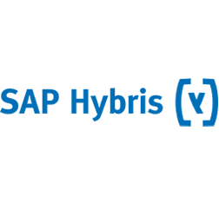









































HPE Future State Architecture
Sales Opportunity
eCommerce & CPQ
Order Management, Supply Chain & Finance
Sales & Partner Comp
Service Delivery & Financial Services
NGQ / OneConfig
Business Process
1
1
+13 Apps
+20 Apps
1
+67 Apps
2
+3 Apps
2
+80 Apps
1
1
2
3
4
2
Integration Fabric
Core Messaging
Orchestration
B2B Gateway
1
2
R&D / Marketing
Information Management
Human Resources
Collaboration & Productivity Tools
Common Core
1
+23 Apps
1
2
+90 Apps
2
+18 Apps
1
+47 Apps
3
1
3
2
4
Security Framework
+8 Apps
Identity & Access Management
Security Operations
1
2
Architecture Key Drivers
Legend
Build on Investments to Date
Leverage Industry Leading Solutions for Rapid Deployment
HPE on HPE (showcase products/services)
Balance of Trade
NGIT Program Focus
Not in NGIT Scope
New Solution
Updated Solution
Unchanged Solution (Boundary Apps)
1
2
3
4
1
2

Slide 9


Key Architecture Decision Drivers
ERP
Industry leading cross-functional ERP core engine for Hi-Tech organizations providing Single source of truth between CRM, Order Management, Supply Chain & Finance
Allows consolidation of disparate systems and adhoc transactional reporting for major business operations
Information Management
Supports industry best practices around Scalability and On-demand growth
Open source big data platforms that supports cross-functional reporting
Enables Self-service reporting to shift away from IT dependency
Flexible and faster data ingestion and consumption mechanisms increasing data availability
CPQ
NGQ
Leverage investments made on CPQ apps and build additional business capabilities and modifications required to support the changing product structure and end state architecture
eCommerce
OneConfig
Tax
Top-rated B2B customer engagement solution offering eCommerce accelerators and consistent user experience
Out of the box integration to S4 Hana and NGIT architecture for information sharing and maintainability
Streamlines tax planning, indirect tax determination, calculation and reporting processes
Procurement
Supplier lifecycle management capabilities that support direct and indirect procurement
Out of the box integration to S4 Hana and NGIT architecture allowing exchange of purchasing, master, and payment data
Sales Comp
Allows easy design of compensation plans through Guided experiences and Out-of-the-box workflows
Middleware
Best in-class Security, Scalability, and Performance that supports real-time integration between modern applications
Provides the variety and velocity to support Big data requirements within the same easy-to-use interface
Master Data
Governance
Consistent master data governance and consumption for products, vendors, and customers

Slide 10
Go-Forward Business Value Chain
Process Area
R&D and Design
Go-to-Market
Operations
(Sales Operations, Supply Chain, and Order Management)
Global Functions
Process Group
Concept to Production
Plan to Market
Quote to Cash
Make/Engineer to Order
Procure to Pay
Request to Service
Record to Report
Hire to Retire
Common Core
Product & Services Lifecycle Management
Perform Go-to-Market Strategy
Configure, Price and Quote
Manufacture Products
Procure Materials and Services
Manage Spare Parts
Manage Accounting and Control Data
Manage Human Resources
Manage Information Technology
Conduct R&D Activities
Market Products and Services
Sales Compensation Administration
Manage Plant & Equipment
Conduct Warehousing & Logistics
Manage Warranty, Repair & Returns
Manage Capital and Risk
Business & Corporate Strategy
Processes
Perform Order Management
Conduct Supply & Demand Planning
Perform Supplier Management
Perform Consulting Services
Perform Statutory Legal & Compliance Reporting
Manage Programs
Manage Billing and Collections
Conduct Sales Planning
Manage Flexible Consumption
Plan & Manage Business
Provide Decision Support

Slide 11
Lead to Cash
Delivering foundational capabilities necessary for IT-enabled business transformation
Engineering & Product Design
Marketing
Sales Automation & CRM
Sales & Partner Compensation
Configure Price Quote eCommerce Engine
Order Mgmt., Supply Chain & Finance
MDM Product, Customer & Finance
Human Resources & Payroll
Digital Experience
Next-gen Analytics
Integration Fabric
IT4IT
Security
Framework

Slide 12
Value Chain Business Data Objects
SFDC
NGQ/HYBRIS
S4/HANA
EAP
COMPENSATION
SALES ORDER
ALL BUSINESS DATA OBJECTS
OPPORTUNITY OBJECT
QUOTE OBJECT
SALES TRANSACTION
Purchase Order
Delivery Document
CUSTOMER
DIMENSION
Billing Document
CONTRACT OBJECT
PRODUCT DIMENSION
EQUIPMENT OBJECT
OTHER DIMENSIONS
DEAL OBJECT

Slide 13
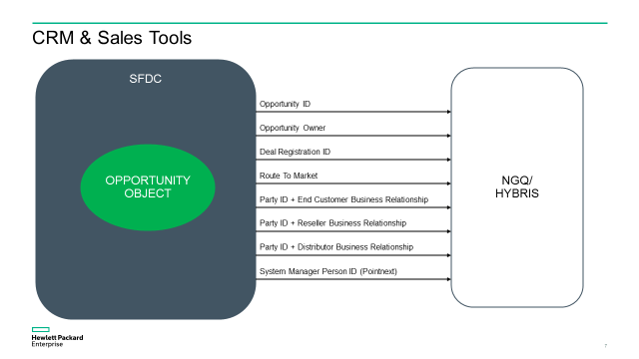
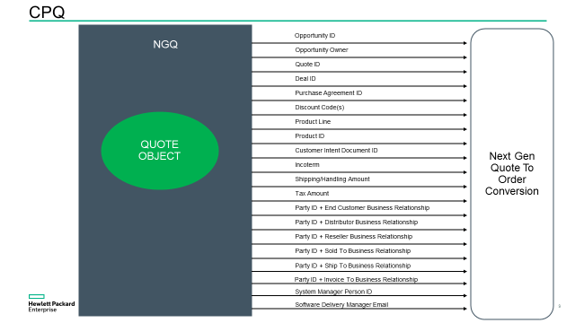
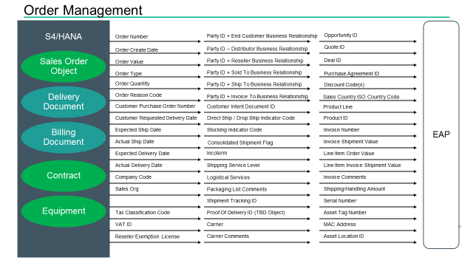
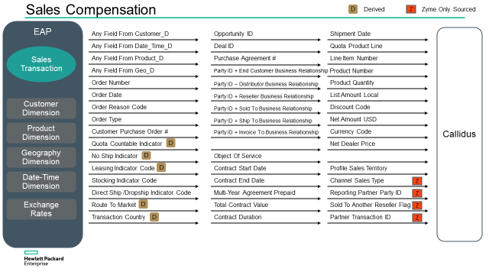
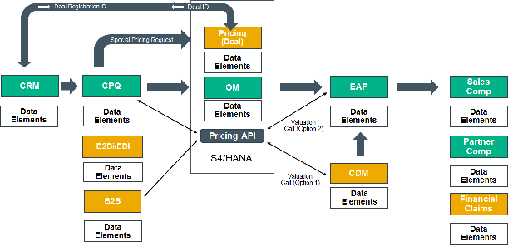
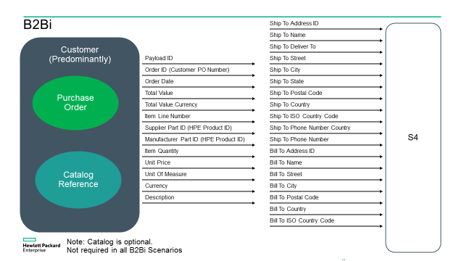
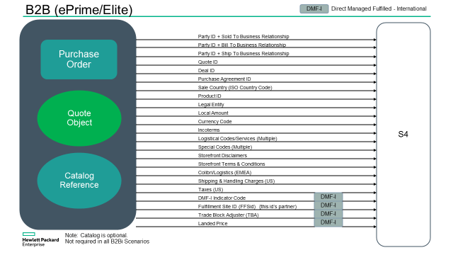
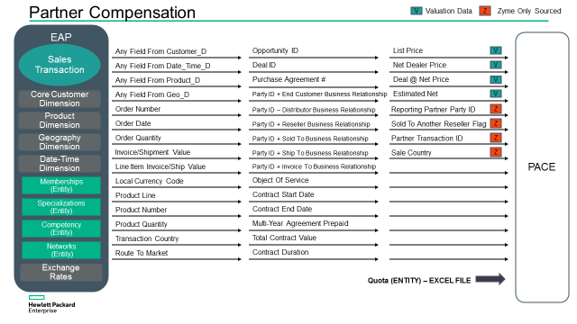
A
B
E
F
A
B
E
F
C
G
D
C
D
G

Slide 14


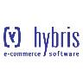







Target State Architecture – Quote to Cash
DRAFT Version: 3.0 Published: 10/6/2017
User Experience
Partner
Ready
Portal (PRP)
HPE.COM
B2B Portal
Opportunity
eCommerce and CPQ
Order Management & Supply Chain
Sales & Partner Compensation
NextGen Catalog
NextGen Quoter
Browse-to-Buy Quote & Cart Engine
Punch
Out
To CPQ
Unified Cart
Punch
out
Hardware Led
Services Led
Cart Management
Product Pages
Personalized templated
Personalized dynamic catalogue
Multi-tenant
SMB
Enterprise
Multi-lingual
Recommendations
Integration to Big Deal approval
Syndicated catalogues
Config validation
Punch
out
Quote Object
Corona
Quote to Order Conversion
(CPQ 2.0)
List price management
Net price calculation
Big deal management
Config validation
Quote Conversion
Services CPQ
Market
Pricing
Config
Sales Configurator
OneConfig Advanced
Validate
Config
Pricing Guidance & Empowerment
Cockpit
PACE/GRS
Partner Comp
Addison Based APIs
Integration Fabric
API
API
Payment
Gateway
Services
AEM
API
API
API
PointNext CPQ functions outside S4
MDM
Standard and Consolidation Hub
Product Content Management
Enterprise Analytics
MDG
Updated Product Structure
Existing apps with integration changes
New apps as part of NextGen IT
14
Existing apps under transformation
Notes:
- Single Quote for the customer
- What’s in O&C - Contracts, Install Base

Slide 15
Platform/Infrastructure View (see visio templates)

Slide 16





Target State Architecture – Order & Service Management
DRAFT Version: 0.5 Published: 10/20/2017
User Experience
Partner
Ready
Portal (PRP)
EDI Orders
B2B Portal
Plan to Market
Quote to Cash
Procure to Pay
Request to Service
Record
to Report
Sales & Partner Compensation
Perform Order Management
Manage Billing and Collection
Conduct Warehousing & Logistics (Logistics)
Manage Warranty, Return, and Repair
Manage Spare Parts
Perform Consulting Management
Mange Flexible Consumption
SERP
Capture Order* / Contract
Backlog Mgmt*
Manage Rebates
Process Order* / Contract
Manage Claims, Returns & Exchanges*
Opportunity
eCPQ
Manage Customer Credit Exposure
Manage Deals
Manage and Track Order*
Manage Chargebacks
Manage Pricing
Global Trade & Compliance
Workflow
PACE/GRS
Partner Comp
Education
Classification
NonStop
MDM
Customer / Partner/Vendor Master
Product Data Management (Product & Services)
Enterprise Analytics
MDG
BOM
Change Mgmt
View Parts
* Products and Parts
New apps as part of NextGen IT
Existing apps under transformation
16

Slide 17
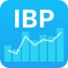
Target State Architecture – Supply Chain
DRAFT Version: 0.5 Published: 10/20/2017
User Experience
Partner
Ready
Portal (PRP)
Parts
Store
B2B Portal
Plan to Market
Quote to Cash
Make to Order
Procure to Pay
Request to Service
Sales & Partner Compensation
Conduct Supply & Demand Planning
Manufacture Products
Perform Supplier Management
Procure Materials and Services (Direct Procurement)
Conduct Warehousing & Logistics (Logistics)
PSA
Supply & Demand
Planning
Field Service Management
MM, SD, PP, WM, Logistics
CPQ
Order Visibility
Procure Parts and Products
Pick, Pack, Ship
Sales Forecasting Control Tower
Inventory
Sourcing
Manage 3rd Party Logistics
Opportunity
Manage Suppliers
Subcontracting
Inbound Logistics
Production Planning
Buy/Sell
Outbound Logistics
Service Delivery
Manage Manufacturing
Customs
Workflow
Transportation
Order Management
Case Exchange
PACE/GRS
Partner Comp
Customs
Direct Procurement,
Contracts,
PO Collaboration
Service Delivery Skills
GSD SC
SFNG - Internal Manufacturing
EG SW Delivery
GLIS/PDAPI/MNP
Fraud (CVS)
Outsourced Manufacturing
PO Collaboration
Generate Projects
Customer / Partner/Vendor Master
Product Data Management (Product & Services)
Enterprise Analytics
MDM
MDG
BOM
Change Management
New apps as part of NextGen IT
Existing apps under transformation
17

Slide 18



Target State Architecture – Finance
DRAFT Version: 1.0 Published: 10/6/2017
User Experience
SmartEDI
B2B Portal
BANKS
Concept to Production
Plan to Market
Quote to Cash
Record to Report
Request to Service
Manage Billing and Collection
Provide Decision Support
Procure Materials and Services
Manage Accounting and Control Data
Manage Capital and Risk
Plan and Manage Business
Service Delivery
Volumetrics UCS
Business Planning & Consolidation Optimized
Tax
Global Template (FICO)
Expenses
New Master Data Model / Enterprise Structure
GL/ Invoice/Logistics/
Product/ Journals
Financial Services
Opportunity
eCPQ
GL
AP
AR
Treasury
Billing
CO
Fixed Assets
Universal Journal – Finance
Claims processing
Application Integration Framework (AIF)
Financial Force
Revenue Accounting and Reporting
Payroll
MDM
Customer / Partner/ Vendor Master
GL Account, Cost Center,
Profit Center, Chart of Accounts, Hierarchies, Vendor Direct, BP
Enterprise Analytics
MDG
New apps as part of NextGen IT
Existing apps under transformation
18
Notes:
- Single Quote for the customer
- What’s in O&C - Contracts, Install Base

Slide 19




Target State Architecture – Sales Compensation
DRAFT Version: 0.1 Published: 10/24/2017
User Experience
Partner
Ready
Portal (PRP)
Opportunity
CPQ
Order Management/
Supply Chain
Channel Data
Sales Compensation
Punch
out
Next Gen Quoter
Metrics, Plans,
Roles, Reps
Q2Order
Orders
Shipments
Deals
Orders, Assignments and Quota
Orders
Partner Data (POS)
Sales Employee
Target Plan
Sales Configurator
OneConfig Advanced
Credit Engine
Enriched Transactional data
Partner
Reported
Data
(POS)
Pre-Processor
Payment
Orders
Shipments
Orders
Biz rules
Opportunities
Integration Fabric
MDM
Standard and Consolidation Hub
Enterprise
Analytics
Payout
Workday
SComp Dimension
HR /
Payroll
MDG
Product
Existing apps with integration changes
New apps as part of Next Gen IT
19
Existing apps under transformation

Slide 20



Target State Architecture – Enterprise Analytics
DRAFT Version: 1.0 Published: 10/10/2017
1
Any Data Source Type
2
Common Ingestion layer
3
Flexible Data Schema
4
Metadata Driven Queries
5
Any Data Consumer Type
Structured, semi-structured, and unstructured data sources
Data ingested in real-time/batch into the data lake
Datasets cleansed, secured, and stored without any pre-conceived schema
Data pulls executed in real-time or batch based on query pattern/and analytical use cases
Datasets consumed using different tools
Multiple Source Systems
Data Ingestion
Layer
Logically Grouped and Cleansed
Raw Datasets with Metadata
Processed and Ready to Use Data Sets
Consume
Enterprise Data Lake
Commmon Ingestion Layer
Integrated Financial Reporting
BI Tools
Transactional
Data Sources
Compliance
Data Quality, Meta Data Management and Security
…..
Deal Reporting
Extracts
Finance
e.g., Balance Sheet, Cost Objects
Sales &
Marketing
e.g., Account, Opportunities
Master
Data Sources
Integrated Sales Reporting
…..
Reports
Supply Chain
e.g., Logistics, Shipments
Services
e.g., Delivery, Warranty
Supply Chain Reporting
Procurement Reporting
Domain Analytics & Reporting Zones
Other Data
e.g., HR, Legacy
Master/Reference/Hierarchies
e.g., Customer, Product
…..
Other Future
Data Sources
Attach Rate
API
Unstructured Data
(Contracts/Surveys/Emails)
Unstructured, Semi-structured Datasets
e.g., Agreements, Email
Install Base
…..
Analytics
Analytical Use Cases
Predictive Analytics

